Slide 1
Easy Diagnosis
Jacob Thomas
Mark Li
Anthony Nguyen

Slide 2


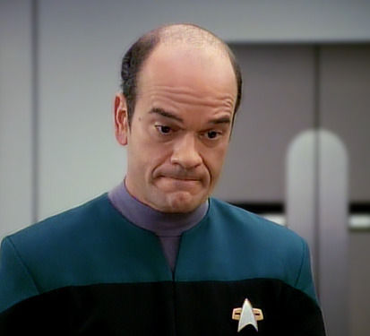



The Inspiration
This Photo by Unknown Author is licensed under CC BY-SA

Slide 3
Our Mission
Create
Create an application to quickly provide diagnosis based on symptoms provided by the user
Incorporate
Incorporate natural language processing to allow users to verbally list symptoms and be diagnosed
Store
Store queries into a database to determine “trending” diseases that many users seem to be experiencing
Analyze
Analyze stored data to improve result quality and integrity

Slide 4
Steps To Create Application
Schema
Create Database schema to store user information
ORM
Create an ORM as bridge between DB and controller
Routing
Create the controller and define routes
Parse
Call Infermedica API to parse out symptoms from speech/text input
AJAX
Send list of symptoms to Infermedica for a diagnosis
Database
Store response in MySql
Display
Show results to user by injecting data into HTML via Handlebars
Design
Spruce up the UI with Materialize Framework

Slide 5







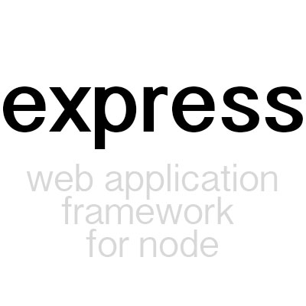
Technology Used
MySQL Workbench
01
Materialize CSS Framework
02
Speech Recognition
03
Infermedica API
04
Node & Express
05
HTML, CSS Javascript
06

Slide 6
Challenges in Development
Passport
Implementing the account and login system via passport.js was time consuming
Collecting Speech
Connecting google speech into the application with vocal input
Async Java
Making sequential SQL queries and having it display on the page proved very challenging.

Slide 7
Future Features
Ease of Use features: more polish
Locating nearby specialists to treat diagnosed illnesses via Google Maps API
Have diagnosis read through a text-to-speech mechanism
Connect to other resources so users can research their diagnosis

